Slide 1
6190 Logistics

Slide 2
6190 logistics, recap
Masters students (1 credit hour)
Several lectures on grad school/career success
Attend 12 faculty research days (usually 2 faculty per day)
Attend 6 external-speaker colloquia
PhD students (3 credit hours)
Attend all faculty talks/colloquia
Also evaluated on research progress in first rotation
Miss no more than two sessions
Attendance – sign-in sheet (honor code)

Slide 3
PhD Rotations, recap
PhD students rotate through one or more research groups before finalizing an advising match
First year broken into rotations of 10, 12, 10 weeks
Goals
Find a good match of advising style and research area interest
Maybe find co-advisors!
Learn about different advising styles and research areas
Learn new research skills, new hot topics
Get excited about research!

Slide 4
More on Rotations
First rotation was assigned based on faculty input
No obligation!
Second/third rotations will be assigned through a matching process
Can opt to do multiple rotations with same advisor
6190 research talks should help you find potential advisors for 2nd rotation

Slide 5
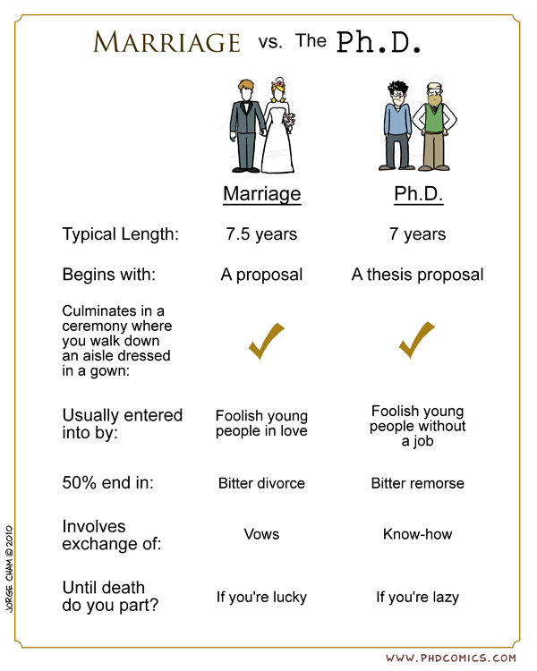
Advisor Selection
Students often rank “research area” too highly
Sign up for classes with potential advisors
Wow them on the semester project
If no class is available: meet with them, spend time in their research group

Slide 6
How is your rotation evaluated?
Mostly, based on progress
Does advisor feel that you are working productively?
Milestones
Proposal – due soon
Documents expectations
Final report – due at end of rotation
What you accomplished
Potentially discuss setbacks and changes in direction
In context of related work
Style and format dictated by rotation advisor
Final presentation to research group
Notes:
This is still a work in progress

Slide 7
Questions?

